Slide 1
Deep Neural Networks
(AIML ZG511)

Slide 2
MODULE # 8 :
Attention Mechanism
Session 11
(19th July 2026)

Slide 3
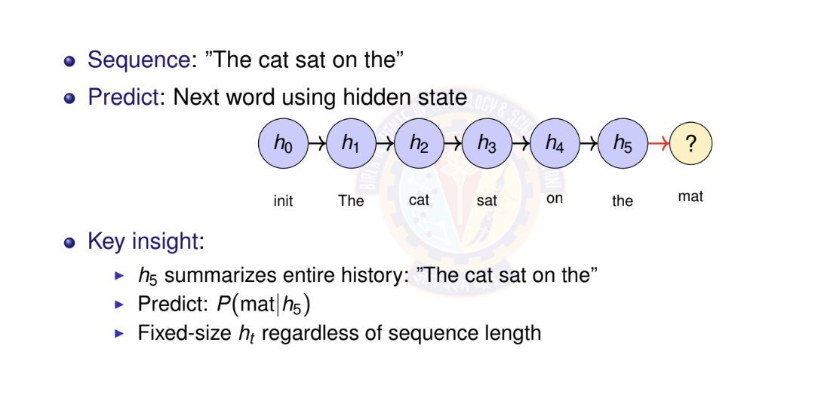
Latent Variable Models: Example

Slide 4
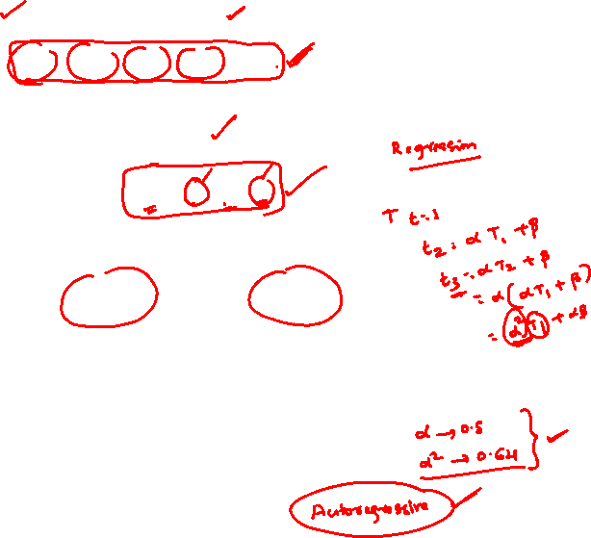
Numerical Example: Temperature Forecasting - Setup
Task: Predict tomorrow’s temperature (regression)
Observed sequence: 20◦C, 22◦C, 25◦C, 24◦C, 21◦C
Approach 1: Autoregressive (First-order)
Linear relationship learned from data:
T_{t +1} = α · T_{t} + β
From historical data, we learned:
α = 0.8, β = 4.0
Example: If today is 25◦C:
T_{tomorrow} = 0.8 × 25 + 4.0 = 24.0◦C

Slide 5
Temperature Forecasting - Autoregressive Prediction
Sequence: 20◦C, 22◦C, 25◦C, 24◦C, 21◦C
Model: T_{t +1} = 0.8 · T_{t} + 4.0
Predict next day (day 6):
Last observation: T₅ = 21◦C
Prediction: T₆ = 0.8 × 21 + 4.0 = 20.8◦C
Multi-step ahead (day 7, using predicted T₆):
T₇ = 0.8 × 20.8 + 4.0 = 20.64◦C
Limitation: Only uses immediate past
Cannot capture weekly/seasonal patterns
Error accumulates in multi-step predictions

Slide 6
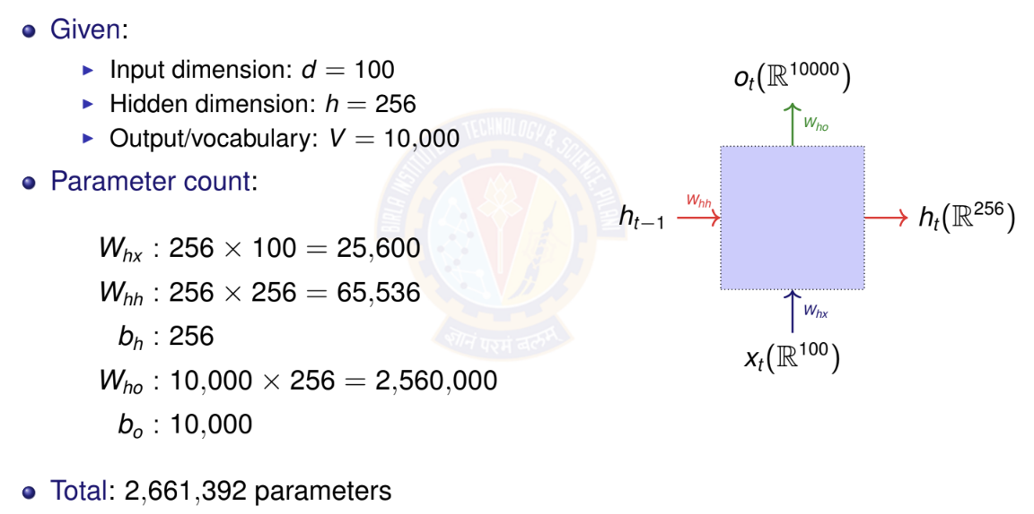
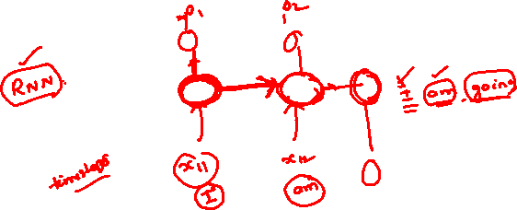
RNN Parameter Counting Example

Slide 7
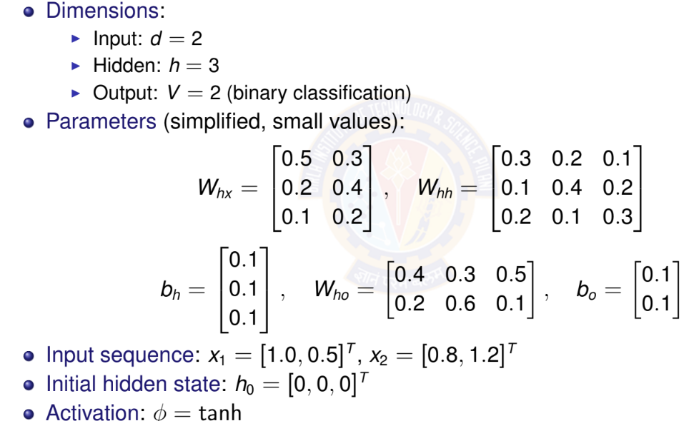

RNN Forward Pass: Simple Example

Slide 8
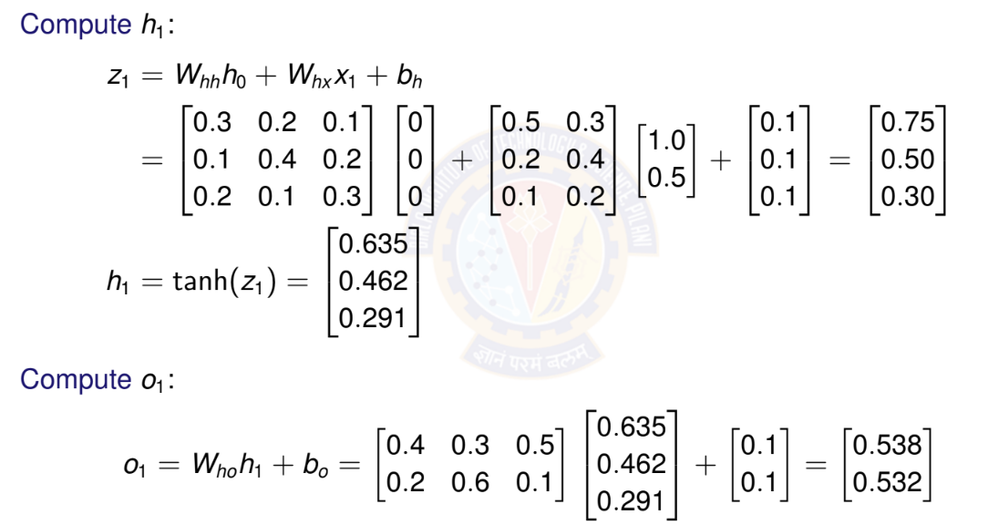

RNN Forward Pass: Time Step t = 1

Slide 9
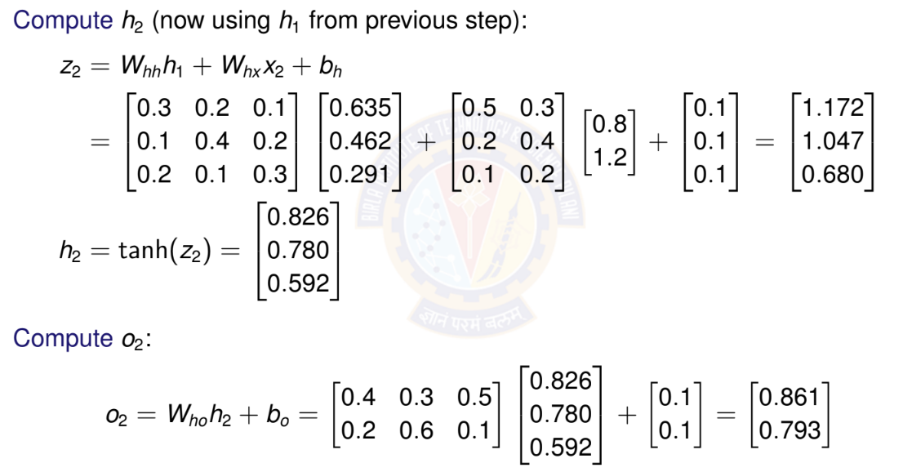
RNN Forward Pass: Time Step t = 2

Slide 10

Activation Functions in RNNs
Common choices for φ:
Hyperbolic tangent (tanh):
Range: [−1, 1]
Centered at zero (helps with gradient flow)
Most common for vanilla RNNs
ReLU:
Range: [0, ∞)
Can help with vanishing gradient
May cause exploding activations

Slide 11
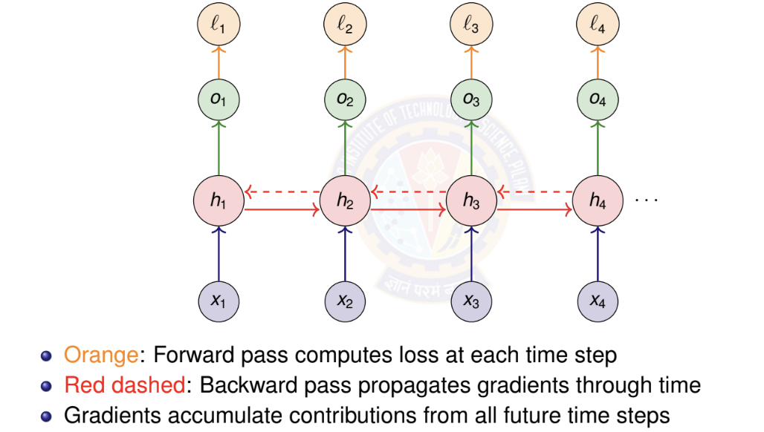
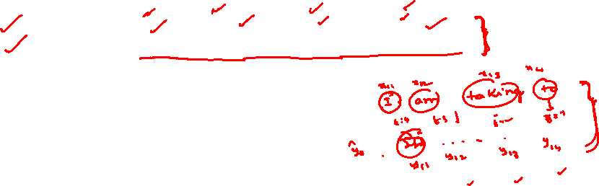
BPTT: Computational Graph

Slide 12
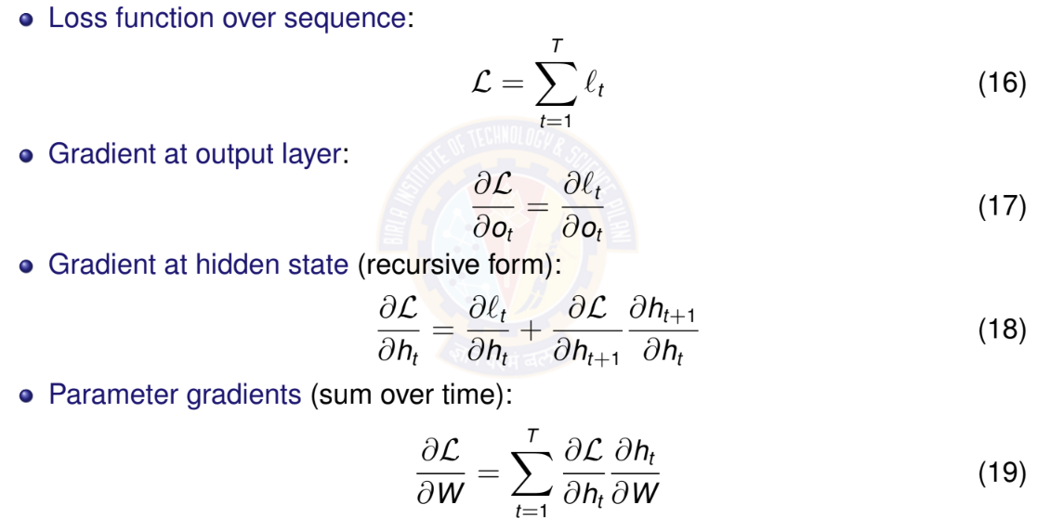
BPTT: Key Gradient Equations

Slide 13
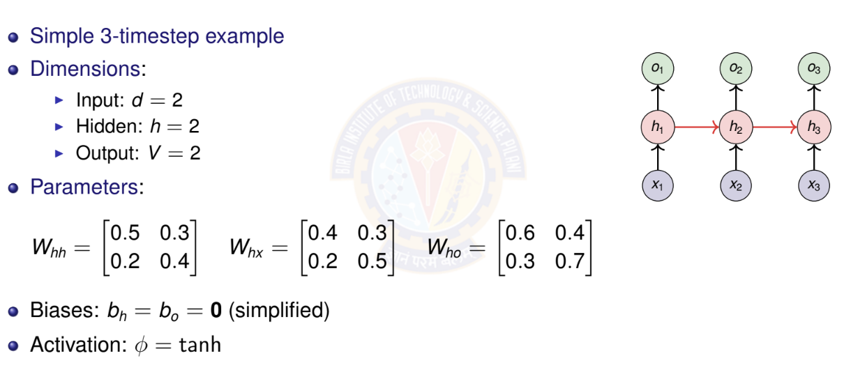

BPTT: Numerical Example Setup

Slide 14
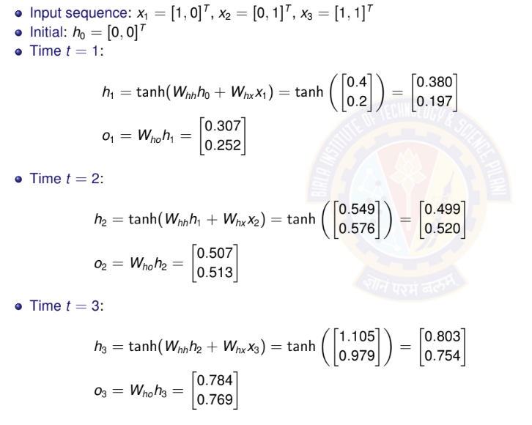
BPTT: Forward Pass

Slide 15
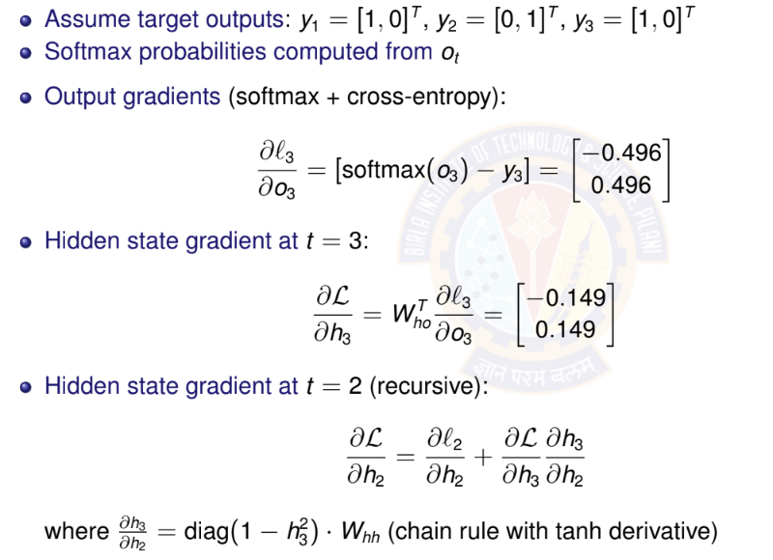
BPTT: Backward Pass

Slide 16
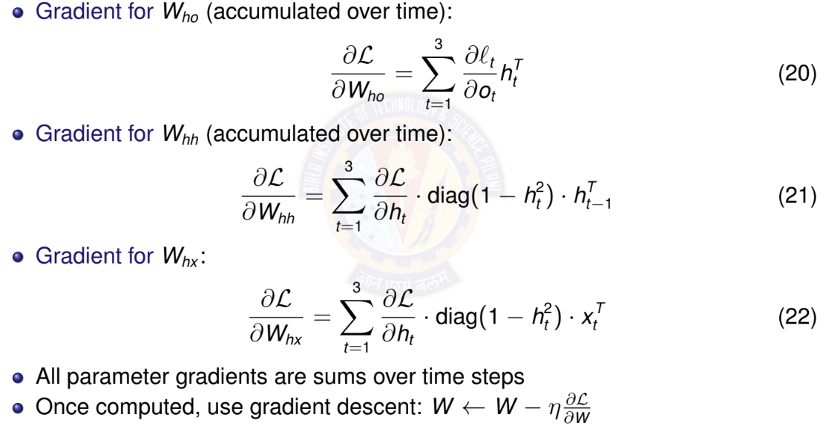
BPTT: Parameter Gradients

Slide 17
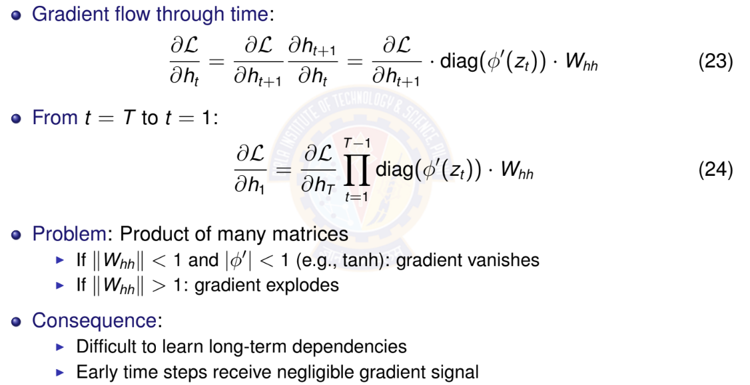
Vanishing Gradients: The Problem

Slide 18
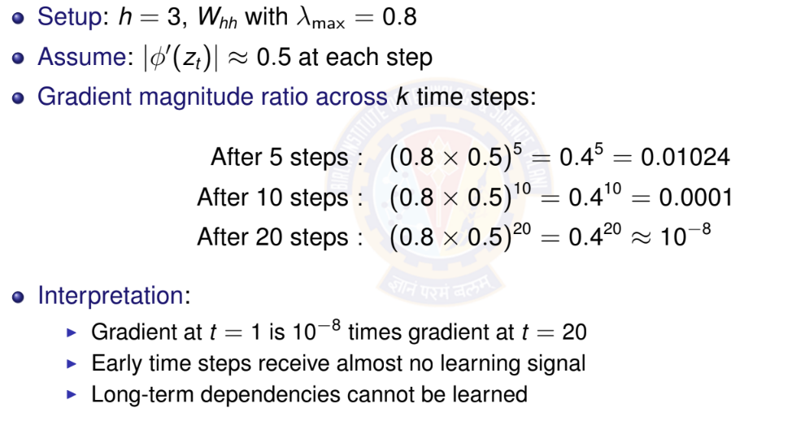
Vanishing Gradients: Numerical Example

Slide 19
Why Vanishing Gradients are Problematic?
Learning difficulty:
Parameters affecting early time steps barely update
Model cannot learn long-term patterns
Training becomes ineffective for long sequences
Example scenarios where this fails:
”I grew up in France... [50 words]... I speak fluent ”
Long-range syntactic dependencies in language
Time series with seasonal patterns (yearly cycles)
Solutions:
Better architectures: LSTM, GRU
Careful initialization
Skip connections

Slide 20
Bidirectional RNNs: Motivation
Limitation of standard RNN: Only uses past context
Predicts based on x₁, . . . , x_{t —1}
Cannot use future information
Many tasks benefit from full context:
Sentiment analysis: ”The movie was not ” (need to see ”good” or ”bad”)
Named entity recognition: ”I met Paris in Paris” (person vs city - need full context)
Speech recognition: Future phonemes help disambiguate current sound
Machine translation: Full sentence context improves translation
Key idea: Process sequence in both directions
Forward RNN: left-to-right
Backward RNN: right-to-left
Combine information from both

Slide 21
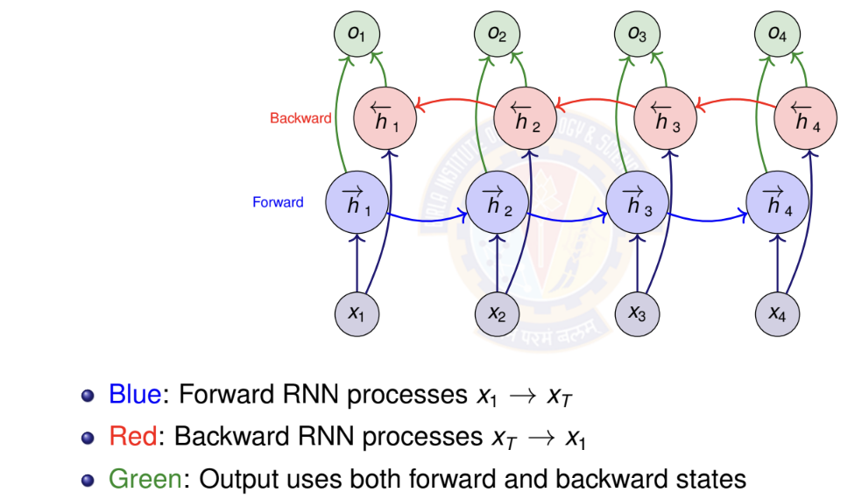

Bidirectional RNN Architecture

Slide 22
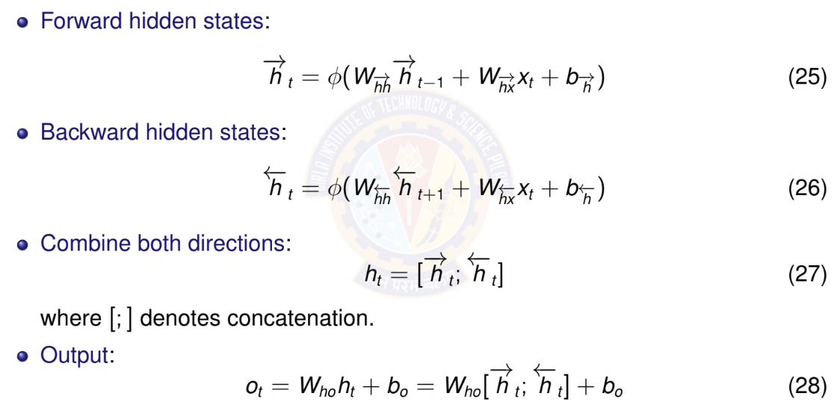
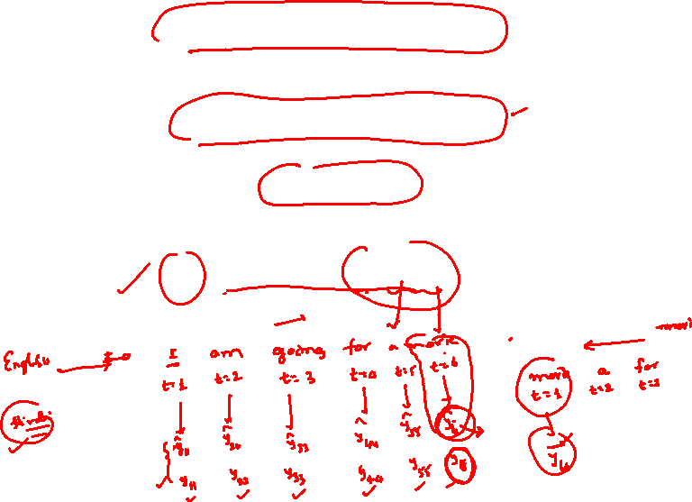
Bidirectional RNN: Mathematical Formula

Slide 23
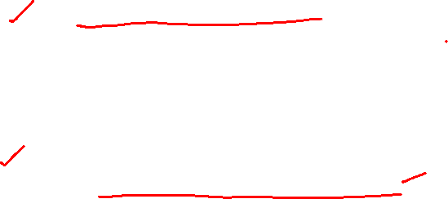
When to Use Bidirectional RNNs
Use bidirectional RNNs when:
Entire sequence available before prediction
Task benefits from future context
Examples: text classification, named entity recognition, machine translation (encoder)
Do NOT use when:
Real-time/online prediction required
Causal modeling (future cannot influence past)
Examples: language modeling, real-time speech recognition, time series forecasting
Key limitation: Must process entire sequence
Cannot make predictions until sequence complete
Higher computational cost (two RNNs)
Not suitable for streaming applications

Slide 24
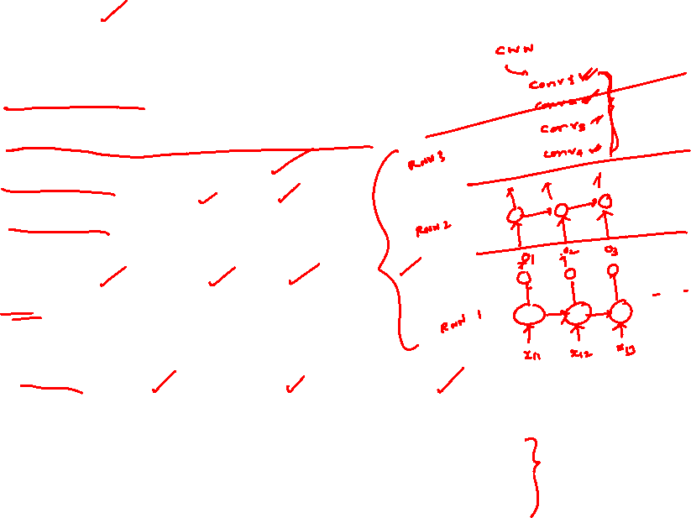
Deep (Stacked) RNNs: Motivation
Why stack RNN layers?
Single RNN layer: limited representational capacity
Deep networks learn hierarchical features
Lower layers: simple patterns
Higher layers: complex, abstract patterns
Examples of hierarchical features:
Text: characters → words → phrases → sentences
Speech: phonemes → syllables → words
Time series: short-term → medium-term → long-term trends
Empirical observation:
Deeper RNNs often outperform wider single-layer RNNs
Typical depth: 2-4 layers (diminishing returns beyond this)

Slide 25
Deep RNN: Gradient Flow Considerations
Gradient must flow through:
Time (horizontal connections within each layer)
Depth (vertical connections between layers)
Compound vanishing gradient problem:
Gradients vanish in time dimension (as in single-layer RNN)
Additional vanishing through depth
Problem is more severe than single-layer RNN
Mitigation strategies:
Use LSTM/GRU cells instead of vanilla RNN (upcoming)
Skip connections between layers (residual connections)
Careful initialization
Layer normalization
Practical limit: Typically 2-4 layers
Deeper networks harder to train
Diminishing returns beyond 4 layers

Slide 26
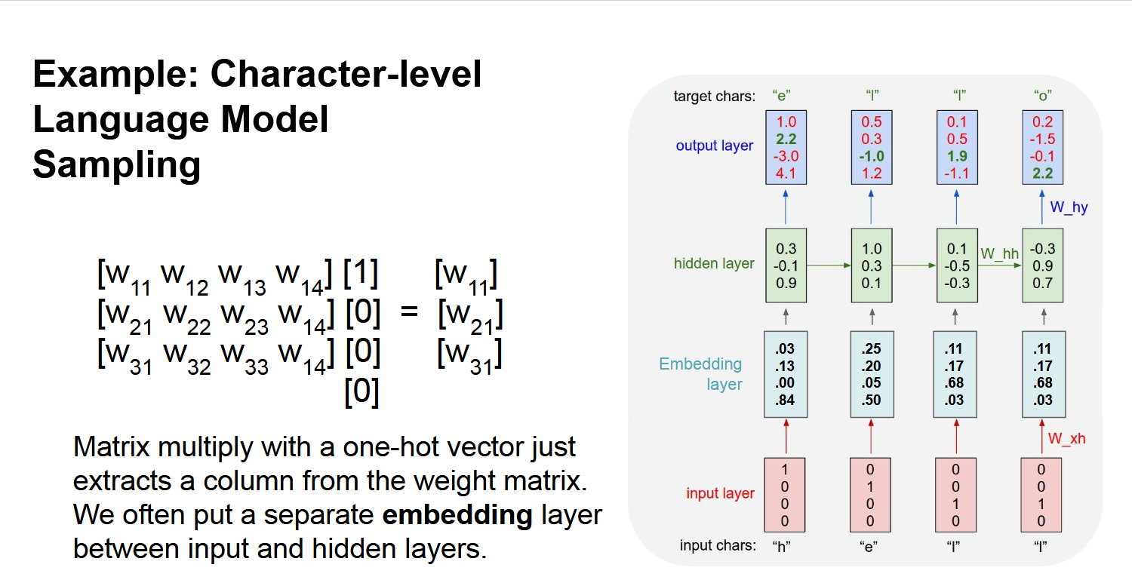
RNN - Example

Slide 27
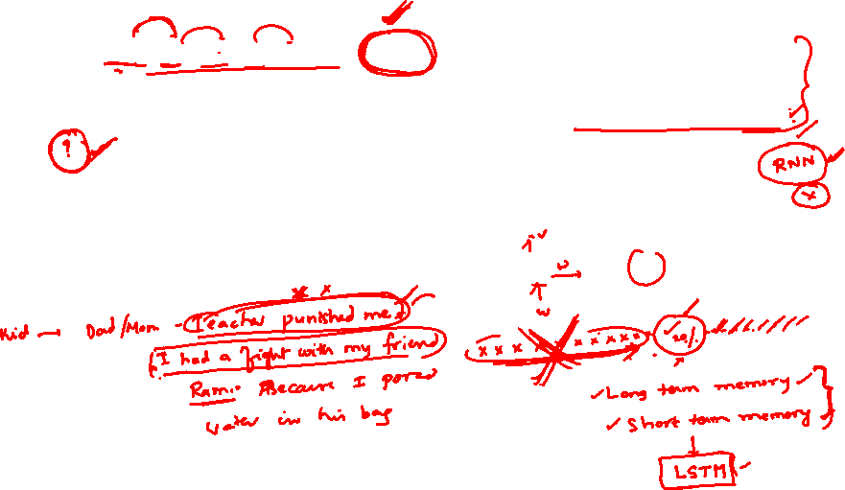
Long term dependency example
Example:
LM task: When she tried to print her tickets, she found that the printer was out of toner. She went to the stationery store to buy more toner. It was very overpriced. After installing the toner into the printer, she finally printed her
Dependency between “tickets” on the 7th step and the target word “tickets” at the end.

Slide 28
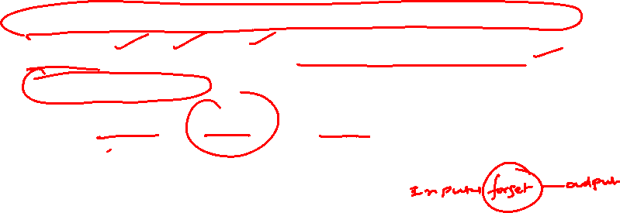
Long Short Term Memory - LSTM
Length of a sentence is an issue with RNN
Vanishing and exploding gradient are issues
LSTM is an extension for RNN , which basically extends the memory
LSTM can read , write and delete information from its memory
LSTN will have 3 gates
i.e. input gate , forget gate and output gate

Slide 29
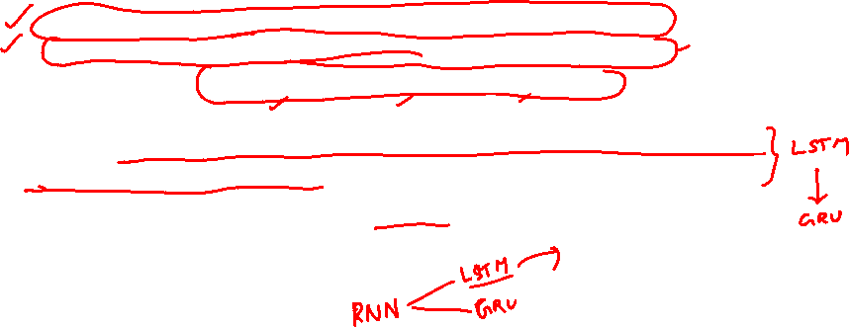
Long Short Term Memory - LSTM
Building block of an LSTM is a memory cell, which replaces the hidden layer of standard RNNs
LSTM unit consists of
  Cell state (C_{t}​) → Responsible for carrying long-term memory.
  Hidden state (h_{t}​) → Represents the output at each time step.
  Three gates → Forget Gate, Input Gate, and Output Gate
LSTM has many variants which include different number of gates and also different arrangement of gates
Another equally popular variant of LSTM is Gated Recurrent Unit(GRU)

Slide 30
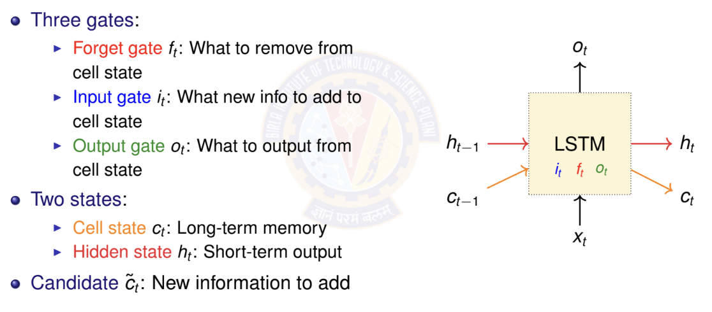
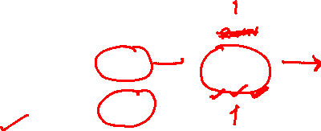
LSTM: Architecture Overview

Slide 31
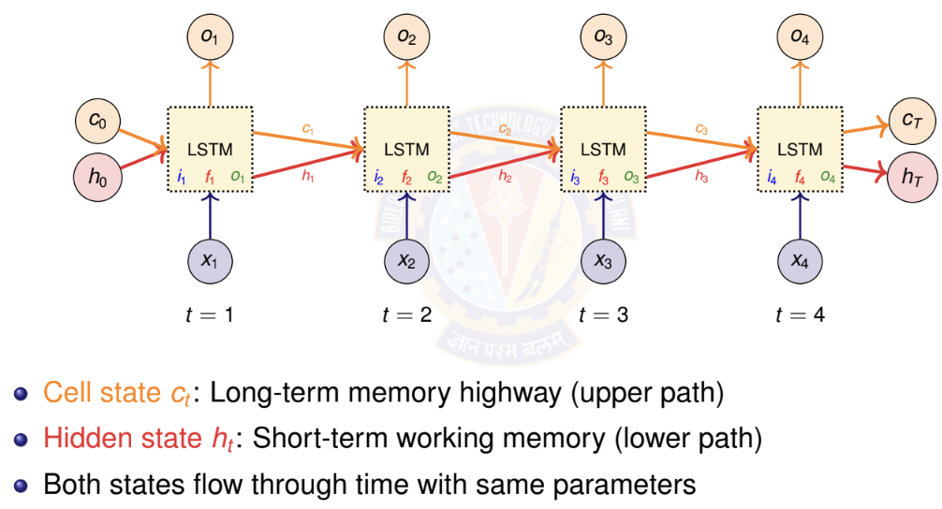
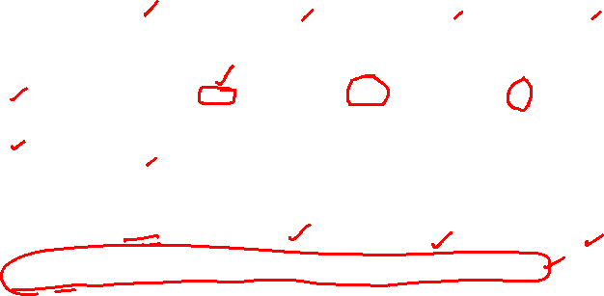
LSTM: Unrolled Architecture Across Time

Slide 32
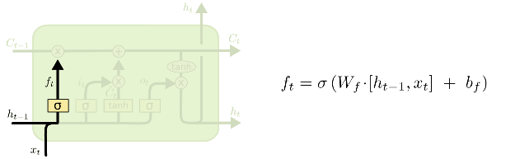
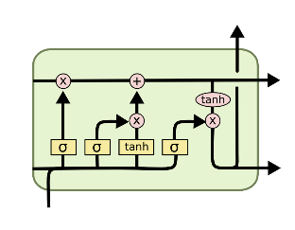
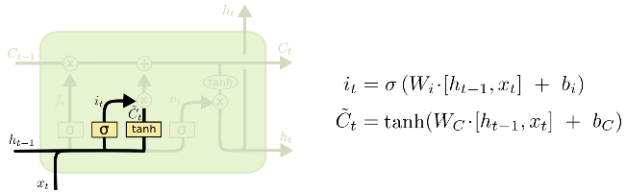
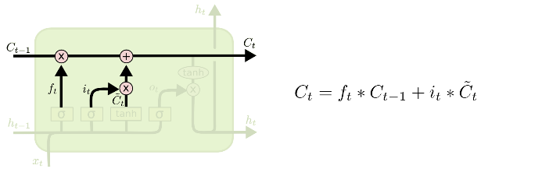
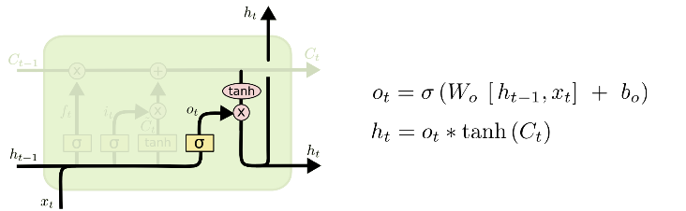
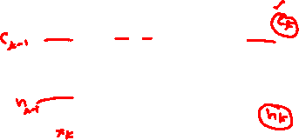
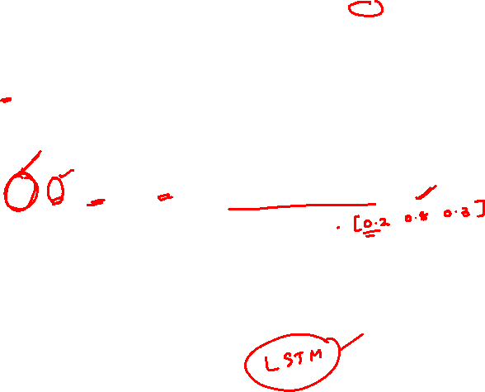
i_{t} decides what component
is to be updated.
C’_{t} provides change contents
Updating the cell state
Decide what part of the cell
state to output

Slide 33


Slide 34
i_{t} decides what component
is to be updated.
C’_{t} provides change contents

Slide 35
Updating the cell state
Decide what part of the cell
state to output

Slide 36
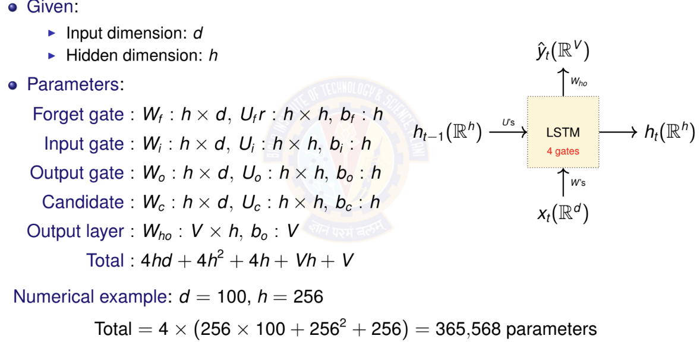
LSTM: Parameter Counting

Slide 37
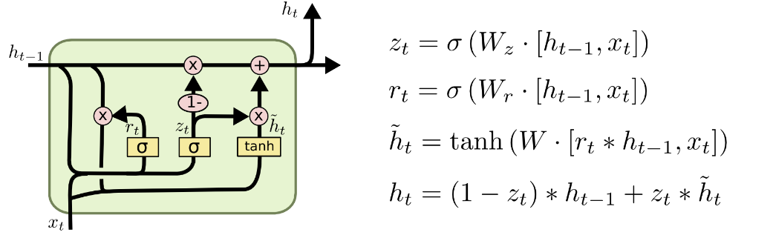

GRU – gated recurrent unit
(more compression)
LSTM
reset gate
Update gate
It combines the forget and input into a single update gate.
It also merges the cell state and hidden state.
This is simpler than LSTM. There are many other variants too.
X,*: element-wise multiply

Slide 38
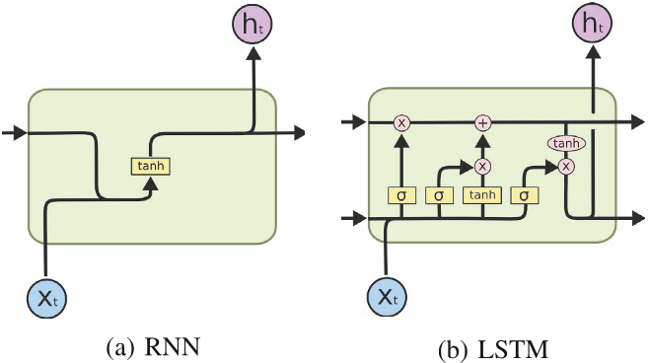
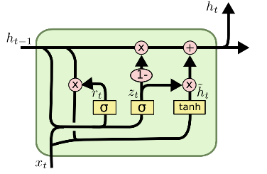
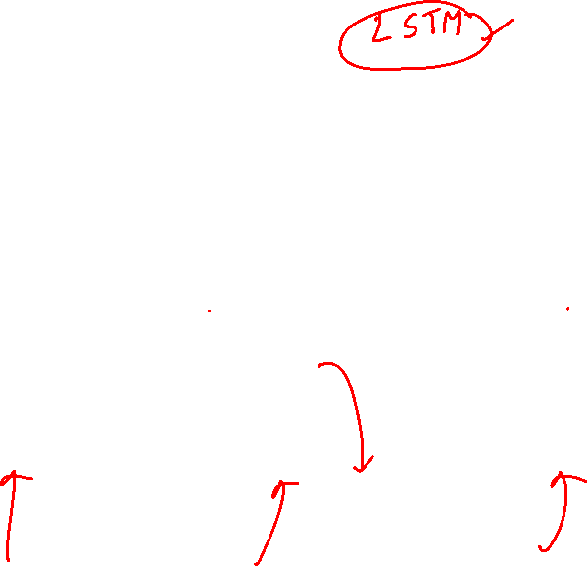
(c)GRU

Slide 39


Gated Recurrent Unit - GRU
Reset Gate r_{t}
    r_{t} ≈ 0, forgets most of h_{t−1}
    r_{t} ≈ 1, retains most of h_{t−1}
Update Gate z_{t}
    z_{t}​ ≈ 0, uses the new candidate memory
    z_{t}​ ≈ 1, keeps the old hidden state

Slide 40


Gated Recurrent Unit - GRU
Candidate Hidden State h_{t}​~
    If r_{t} is low, resets the hidden state
    If r_{t} is high, retains past memory
Final Hidden State h_{t}
    If z_{t} ​≈ 1, keeps the old state
    If z_{t}≈ 0, replaces it with new memory

Slide 41
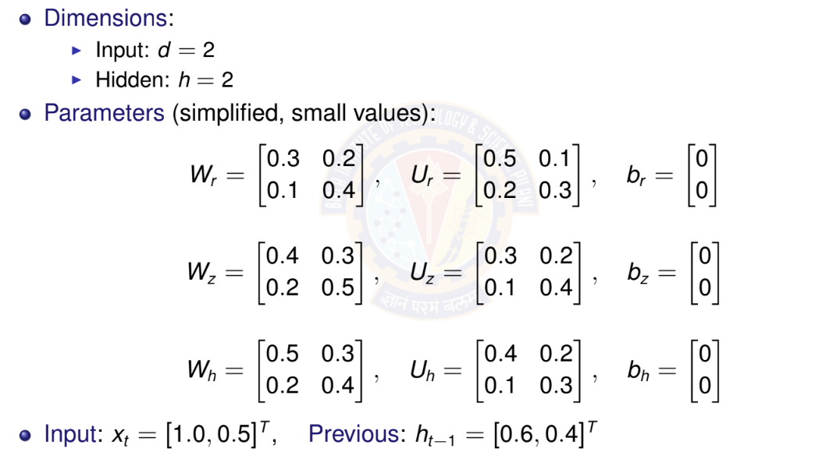
GRU: Numerical Example - Setup

Slide 42
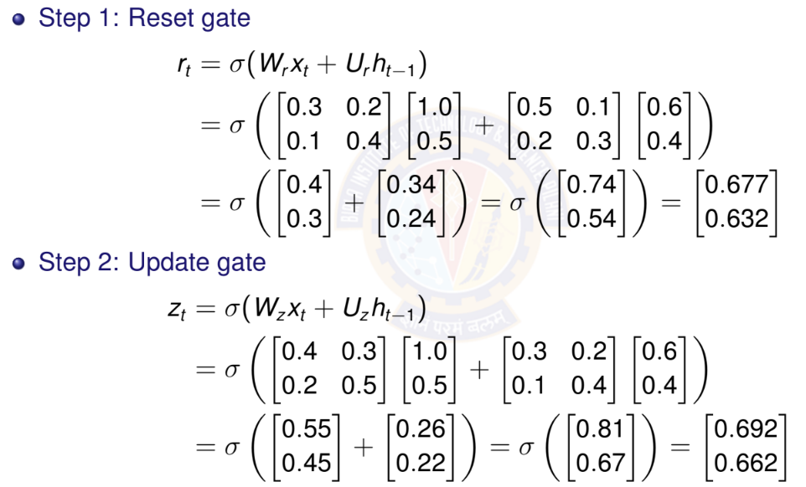
GRU: Numerical Example - Gates Computation

Slide 43
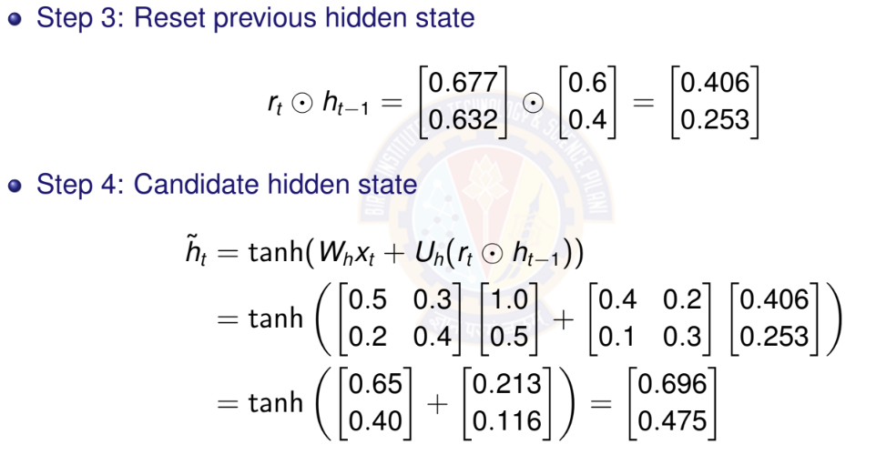
GRU: Numerical Example - Hidden State Update

Slide 44
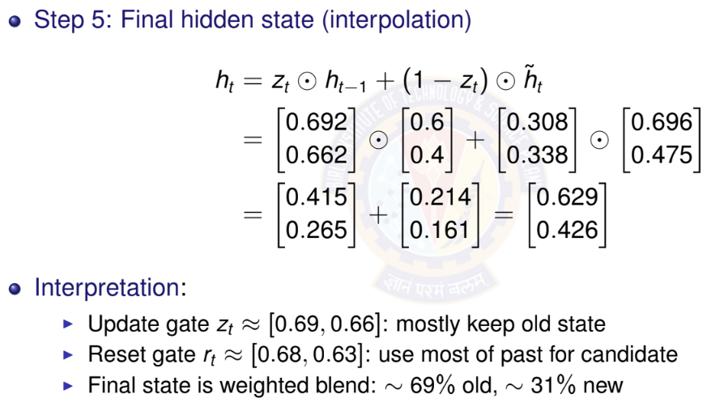
GRU: Numerical Example - Final Hidden State

Slide 45
LSTM vs GRU: Comparison
Property | GRU | LSTM
Number of gates | 2 (reset, update) | 3 (forget, input, output)
Memory types | 1 (hidden state) | 2 (cell + hidden)
Parameters | 3(hd + h² + h) | 4(hd + h² + h)
Relative params | Fewer (∼ 25% less) | More
Training speed | Faster | Slower
Memory usage | Lower | Higher
Gradient flow | Good | Excellent
Long sequences | Good (50-100 steps) | Better (100+ steps)
Popularity | Increasing | Most widely used
When to use GRU: Smaller datasets, shorter sequences, faster training
When to use LSTM: Longer sequences, more data available, maximum performance needed

Slide 46
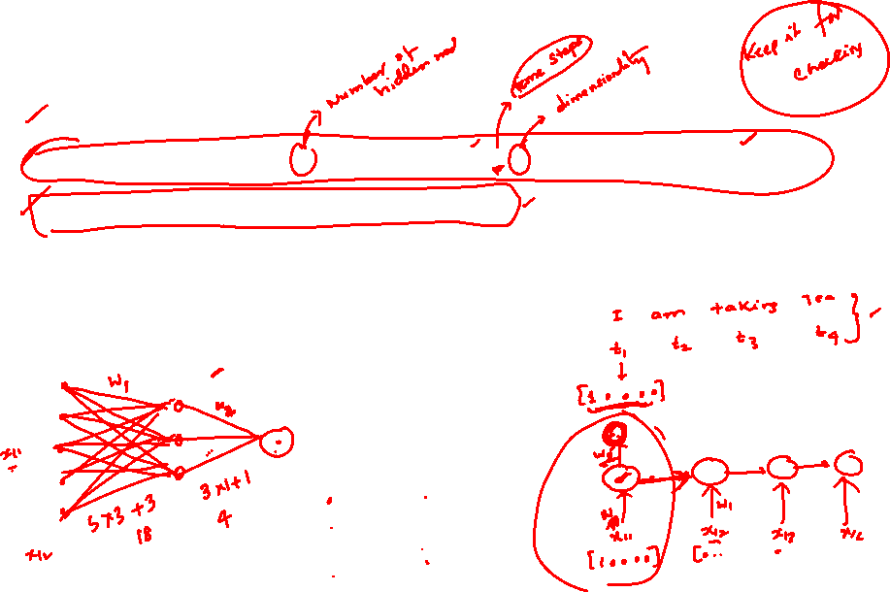
Numerical on RNN
Consider the following snippet
Model = Sequential()
Model. add(SimpleRNN(3, input _ shape= (4,5),activation=activation[0]))
Model . add(Dense(1,activation= “Sigmoid”)
Draw the architecture
Calculate total number of Parameters in this

Slide 47
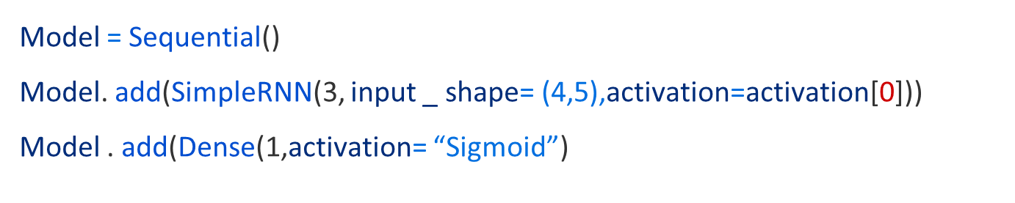
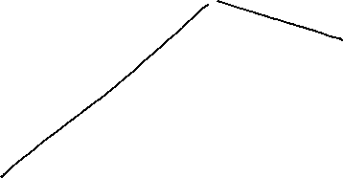


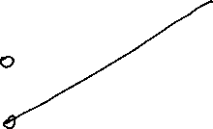


Discussion 1 _Continued

Slide 48
Numerical on RNN
Consider the following code snippet and draw the corresponding architecture. And also calculate number of parameters.
Model = Sequential()​
Model. add(SimpleRNN(4, input _ shape= (4,6),activation=activation[0]))​
Model . add(Dense(1,activation= “Sigmoid”)​

Slide 49
Total number of Parameters:
RNN Layer: Wxh + Whh + bh = 4*6 + 4*4 + 4 = 44
Output Layer: Wo = 1*4 and bo: 1 1*4 + 1 = 5
Total number of parameters: 44+5 = 49

Slide 50
Numerical on RNN
Compute the outputs in each timestep and the state after timestep = 3 for the Vanilla RNN given below. Assume the biases as zeros.
X = [ 1 1 0]^{T}
W = [ 0.2 0.3 0.8]^{T}
U = [ 0.5 0.6 0.2]^{T}
V = [0.4 0.2 0.1]^{T}

Slide 51
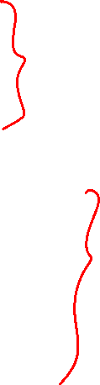
Discussion 3
s₀ = 0
s_{t} = σ(Ux_{t} + Ws_{t−1} + b)
yˆ_{t} = g(Vs_{t} + c)
Compute the outputs in each timestep and the state after timestep = 3 for the Vanilla RNN given below. Assume the biases as zeros.
X = [ 1 1 0]^{T} W = [ 0.2 0.3 0.8]^{T} U = [ 0.5 0.6 0.2]^{T} V = [0.4 0.2 0.1]^{T}

Slide 52

Numerical on RNN
A company is trying to automate generating reports from videos of ultrasound scans. The videos of a beating heart of fetus at a particular section or slice. The report to be generated describes the heart condition and its location and any abnormalities detected. The videos are of 36 frames each. Each frame is 360 x 240 grayscale image,
Suggest suitable type of RNN to be used for this application and justify your selection.
Compute the depth of the RNN suggested
Should an LSTM or GRU or Bidirectional RNN should be used for this application. Justify your choice.

Slide 53
Numerical on RNN
A company is trying to automate generating reports from videos of ultrasound scans. The videos of a beating heart of fetus at a particular section or slice. The report to be generated describes the heart condition and its location and any abnormalities detected. The videos are of 36 frames each. Each frame is 360 x 240 grayscale image,
Suggest suitable type of RNN to be used for this application and justify your selection.
Compute the depth of the RNN suggested
Should an LSTM or GRU or Bidirectional RNN should be used for this application. Justify your choice.
Many to Many RRN has to be used. For each frame ,the position of the fetus and the condition has to output
Depth = 36,the number of frames per video
LSTM is better

Slide 54
Why
Many NLP tasks require variable-length sequence-to-sequence mapping:
Sentiment Analysis:
Input: ”The phone battery lasts only 2 hours. Very disappointed.”
Output: ”Negative”
Question Answering:
Input: Context + ”What is the capital of India?”
Output: ”New Delhi”
Text Summarization:
Input: 500-word article
Output: 50-word summary

Slide 55


Slide 56


Slide 57


Slide 58


Slide 60


Slide 61


Slide 63


Slide 64


Slide 66


Slide 67


Slide 68


Slide 69


Slide 70


Slide 73


Slide 110



